Slide 1


SOMERSET PURPOSE
Somerset Academy, Inc. promotes a transformational culture that maximizes student achievement and the development of accountable, global learners in a safe and enriching environment that fosters high-quality education.
S - Set high expectations
O - Objective
M - Meaningful curriculum
E - Effective
R - Resourceful and responsible life long learners
S - Scholars who achieve proficiency and beyond
E - Evaluate continuously and use data to drive curriculum
T - Teachers who are highly qualified

Slide 2

DO NOT. . .
“Hang out” in the stairwells or on the second floor during lunch.
Chew gum. DO NOT BRING GUM!
Go on the basketball court with a skateboard!
Use the elevator without approval from the office.
Leave campus if you are a Middle Schooler, Freshman or Sophomore (Except for DE students)
Allow an underclassmen in your vehicle without prior permission, or you will lose all privileges for the remainder of the school year.
Throw anything off the balcony.
Throw anything from the ground level to the 2nd floor.
Eat or carry food over the basketball court or turf field
Litter or leave garbage around at lunch
Hang out by the wavy wall side or behind the basketball court bleachers
Hang on or grab the basketball nets/rims
Playing “keep away” = a detention
Yoga pants/ leggings/ are not allowed. Not even during dress down days. Dress code violations earn detentions
You are not to go to the Deans’ office during class to argue a detention. You will be turned away.

Slide 3
Discipline
Discipline is applied with mutual respect in a firm, fair , reasonable and consistent manner.
Preventive Morning announcements, Teacher and School's Rules & Expectations
Supportive Warnings for students to get back on task. Email notification to parents
Corrective Weekly Monday Detentions, Monthly Saturday Detentions

Slide 4

No Cell Phones
Off and away the entire day
1st Violation – Detention
Parent notification submit phone to main office
2nd Violation – Saturday Detention
Parent notification submit phone to administration
3rd Violation – Referral Suspension & Behavior Probation
Device must be picked up by a legal guardian

Slide 5
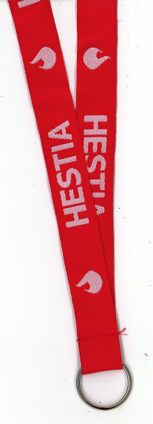
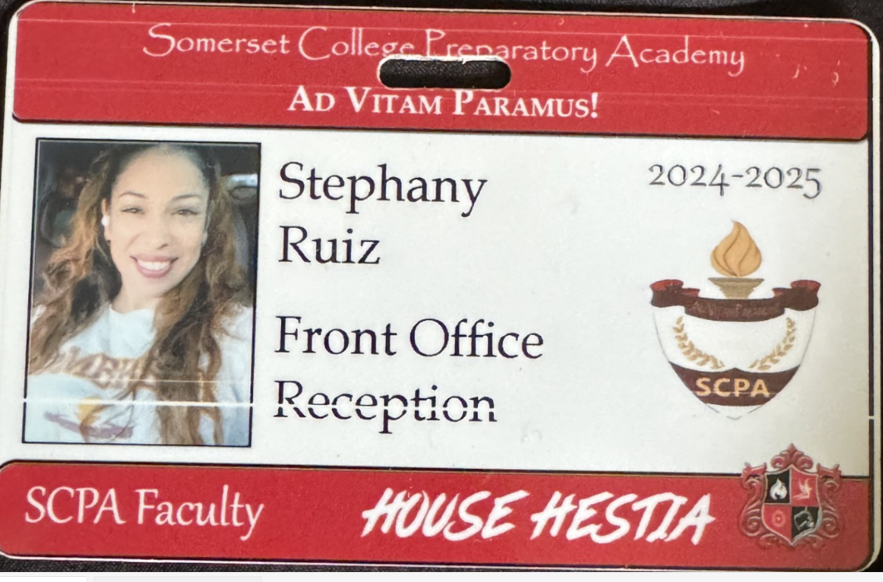
Lanyards and IDs are a Mandatory
Part of your uniform
Keep in your backpack
Needs to be worn everyday you’re at school
No Lanyard and ID will result in a dress code violation.
Purchase in Front Office
Lanyard $3
ID $2 (Cash Only)

Slide 6
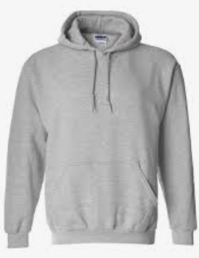

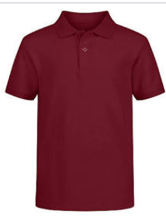
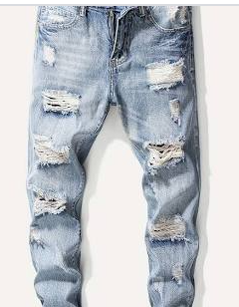
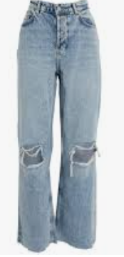
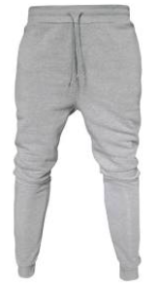


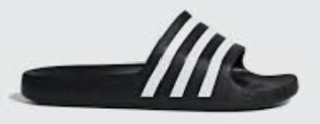
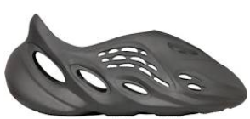
Dress Code Violations (Do Not Wear)
Ripped or Frayed Jeans
Non - Somerset, Hoodies or Polos
Crocs, Slides & Foam Runners
Sweatpants, Joggers, Yoga pants, tights or Pajama pants

Slide 7
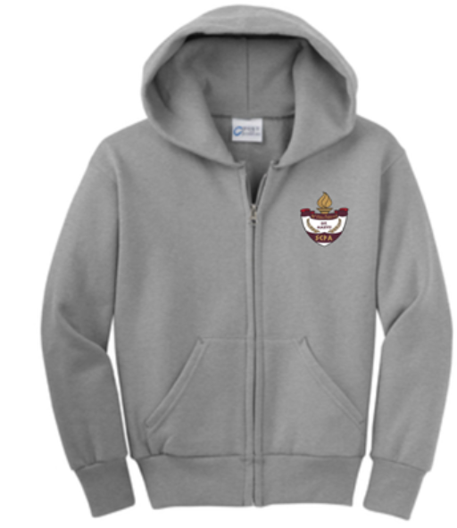
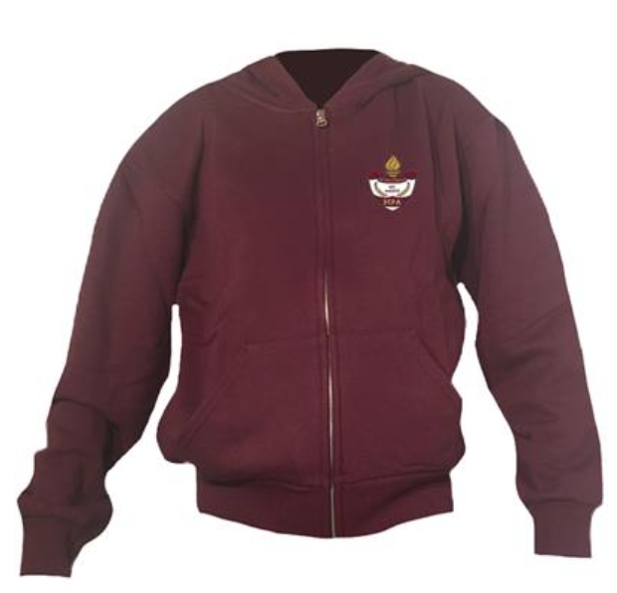
Dress Code Violations
A Somerset College Prep shirt must be worn underneath a zip up Hoodie or Jacket.
Exceptions would include
House Shirts on Thursday's
School Friday Shirts
Club Shirts
School Athletic apparel for game days.
Anyone not in compliance will be given a Dress Code Violation according to our Discipline Matrix.

Slide 8
Discipline Matrix (Uniform Violation)
Lunch Detention
Saturday Detention
Saturday Detention. 9:30am to 12:30pm
Monday Detention
Suspension
2 Day Suspension
Referral 9-week behavior probation contract.
1 Day suspension
Referral
Student not welcomed back following year.
2 Day suspension
1st Offense
2nd Offense
3rd Offense
4th Offense
5th Offense
Every Friday
12:00 – 12:30
Detention slip will allow
Student access to front of
lunch line
Every Monday afterschool. 3:50pm to 4:50pm in cafeteria
Tuesday if school is closed Monday

Slide 9
Somerset College Prep Discipline Matrix
*Warnings* Do Not apply to all discipline. Teacher & Staff discretion
DETENTION
SATURDAY DETENTION
SUSPENSION including DISMISSAL
3:50 to 4:50pm
Classroom Disruption
Disruptive Conduct
Chewing Gum
Bus Violation
Disrespect for others or property
Uniform Violation
Littering during lunch
Electronic Confiscation
Public Display of Affection / P.D.A
Profane Obscene Abusive Language
Running in the Halls
Spray used in the Restrooms
Tardy to Class
Tardy to School ( 3 late arrivals non bus rider)
Excessive Detentions / Unserved Detention
Theft
False or Misleading Info
Open Defiance of Authority
Vaping / Alcohol
Physical Altercation
Fighting or Attempting to Fight
Assault / Intimidation Threat of Student
Weapons
Other Major Misconduct
9:30 to 12:30pm
Horseplay
Missed Detention
Multiple Detentions
Disruptive Conduct
Bus Violation
Skipping = 2 Saturday Detentions, Referral & 9 week Behavior Probation Contract
Cheating = 3 Saturday Detentions, Referral & Behavior Probation Contract

Slide 10
Somerset Discipline Matrix
Lunch Detention
Saturday Detention
Saturday Detention. 9:30am to 12:30pm
Conceirge email sent to parents
Monday Detention
Suspension
2 Day Suspension
Referral 9-week behavior probation contract.
1 Day suspension
Referral
Student not welcomed back following year.
2 Day suspension
1st Offense
2nd Offense
3rd Offense
4th Offense
5th Offense
Every Friday
12:00 – 12:30
Conceirge email notification
Sent to parents
Detention slip will allow
Student access to front of
lunch line
Every Monday afterschool. 3:50pm to 4:50pm in cafeteria
Tuesday if school is closed Monday

Slide 11
Missed Detention Consequences
Missed Lunch Detention = Afterschool Detention
Missed Afterschool Detention = Saturday Detention
Missed Saturday Detention =
2 – Day Suspension
Referral & Behavior Probation

Slide 12




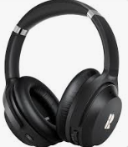

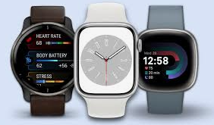
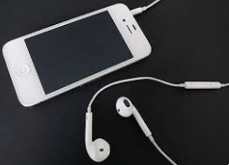
No Wireless Communication Devices
Off & Away for the entire day
No Devices
Smart Watches, Earphones, Tablets

Slide 13
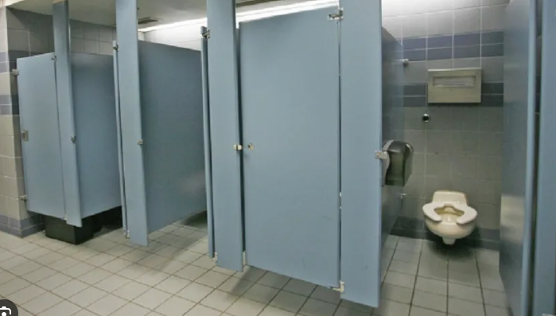
ONE (1) Student in a Stall at a time!
This includes the Large Stall!!
Consequences will be distributed.

Slide 14
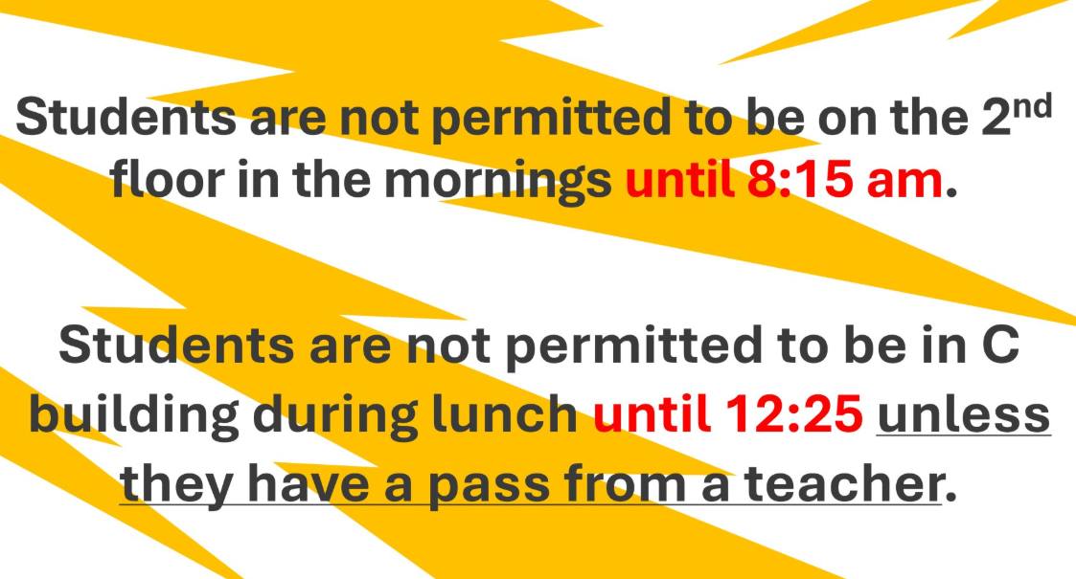

Slide 15
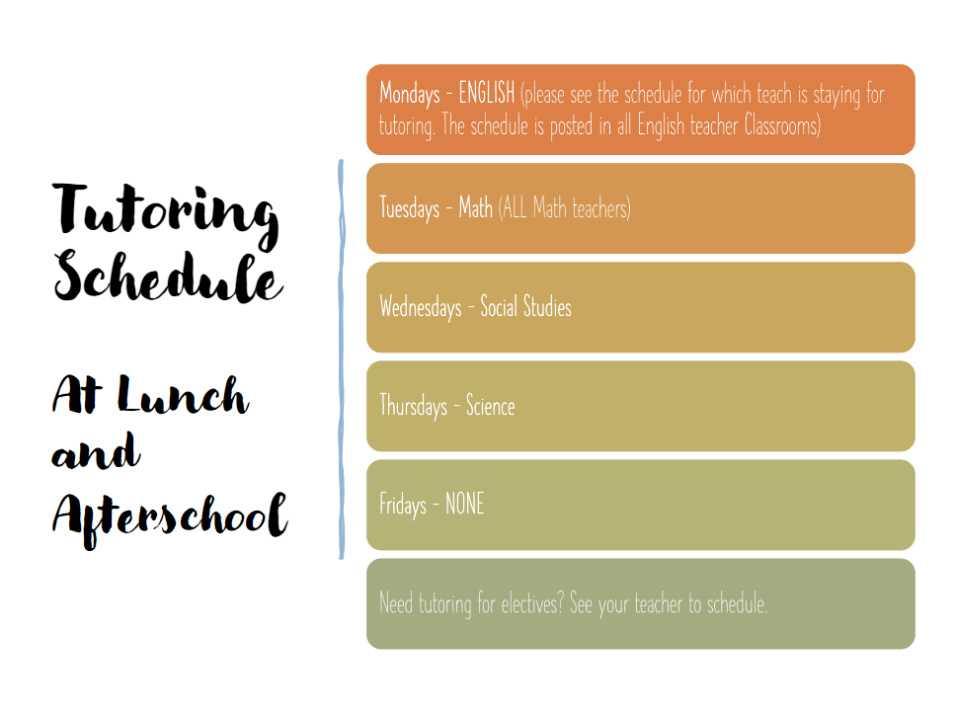

Slide 16
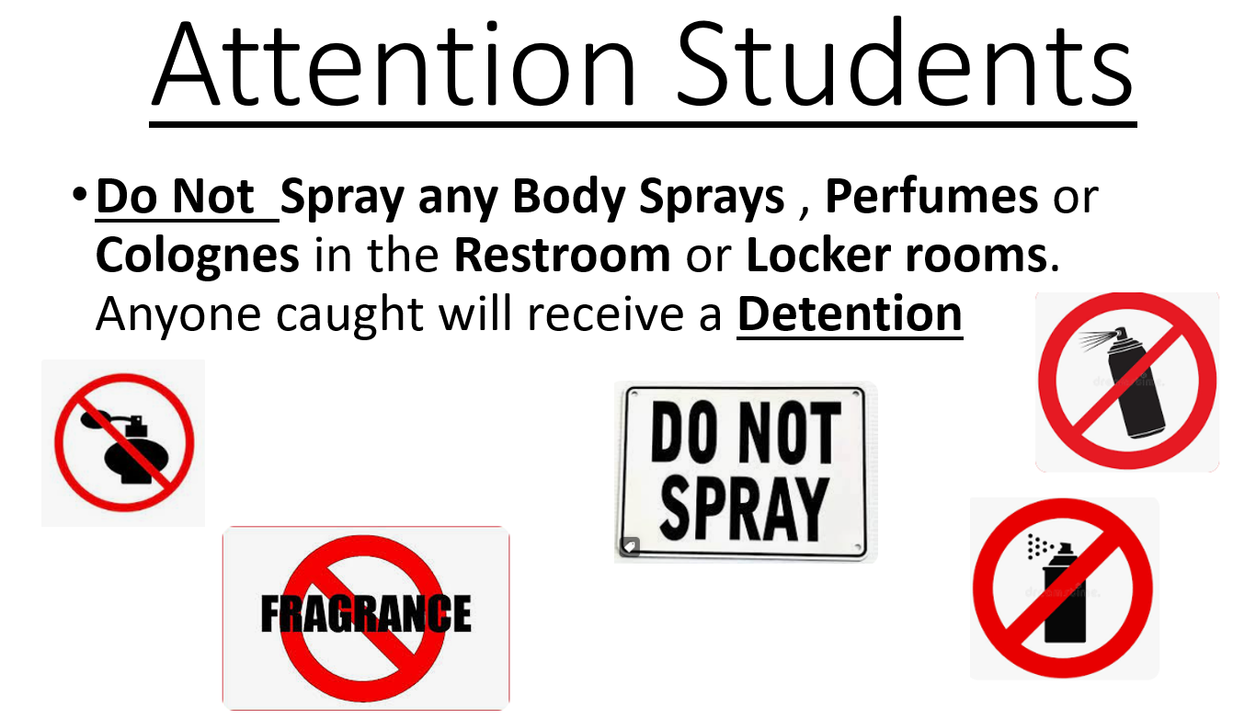

Slide 17
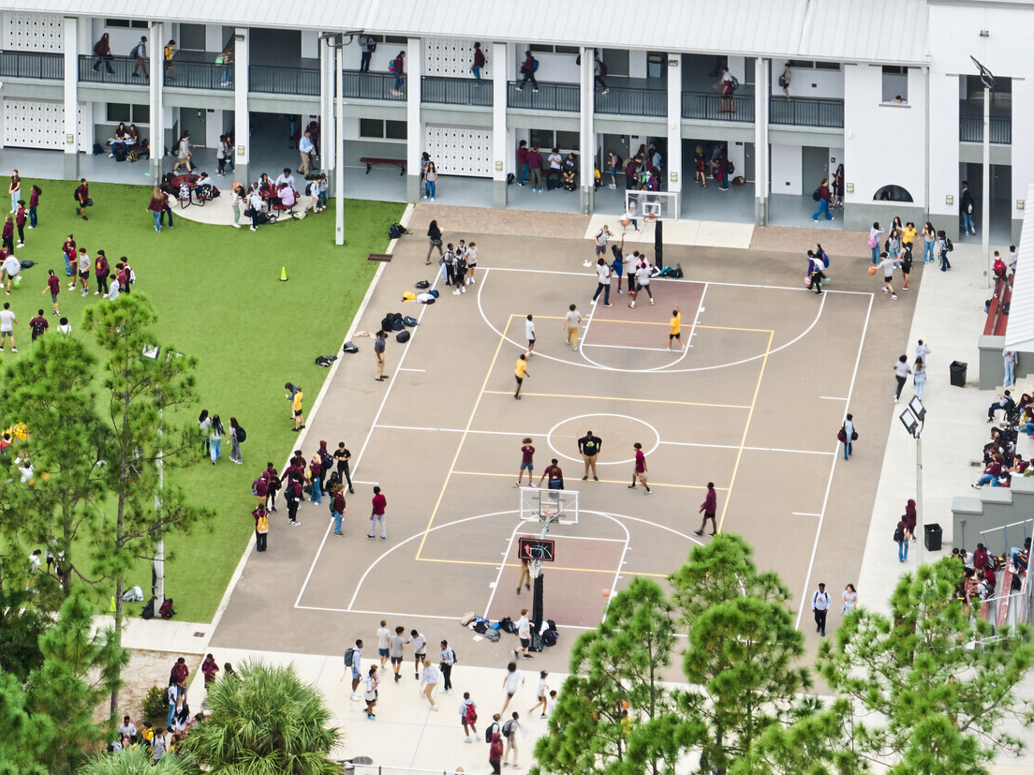
NO FOOD or drink ON THE COURT

Slide 18
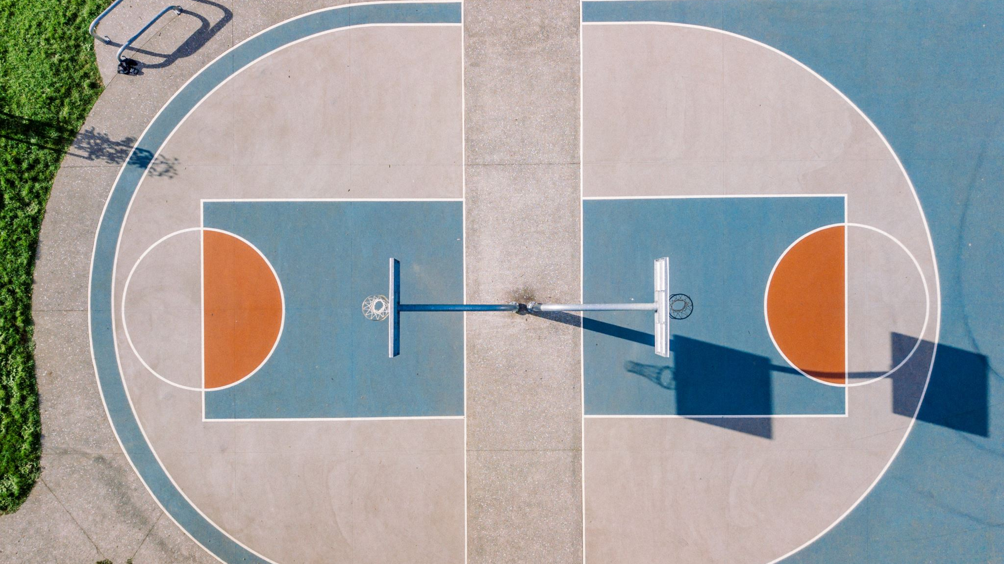
on basketball courts OR turf without a staff member present
(This means mornings & after school too.)
NO Playing ANY SPORTS

Slide 19
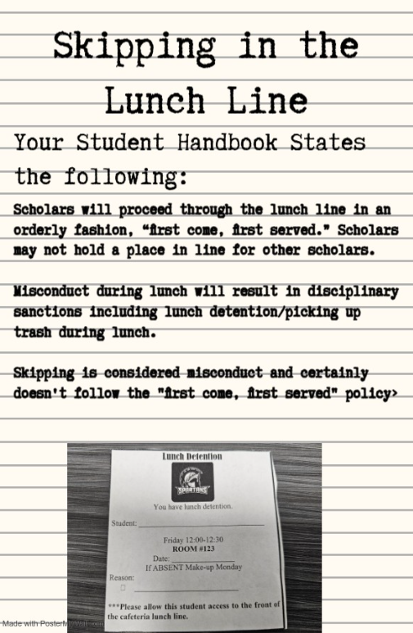


Slide 20
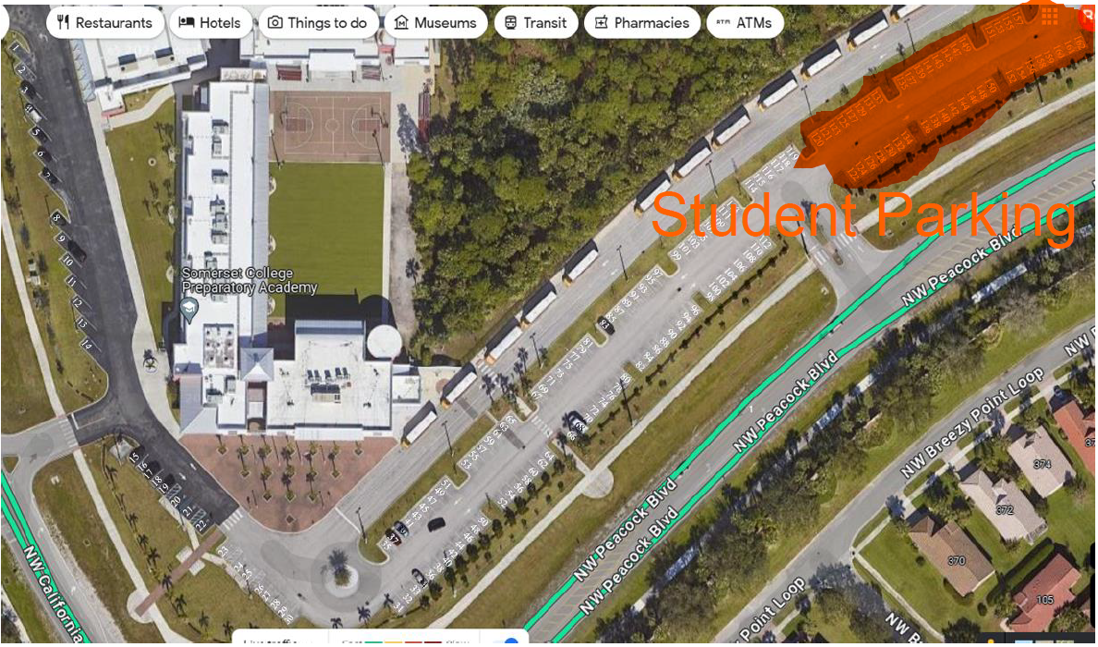

Slide 21
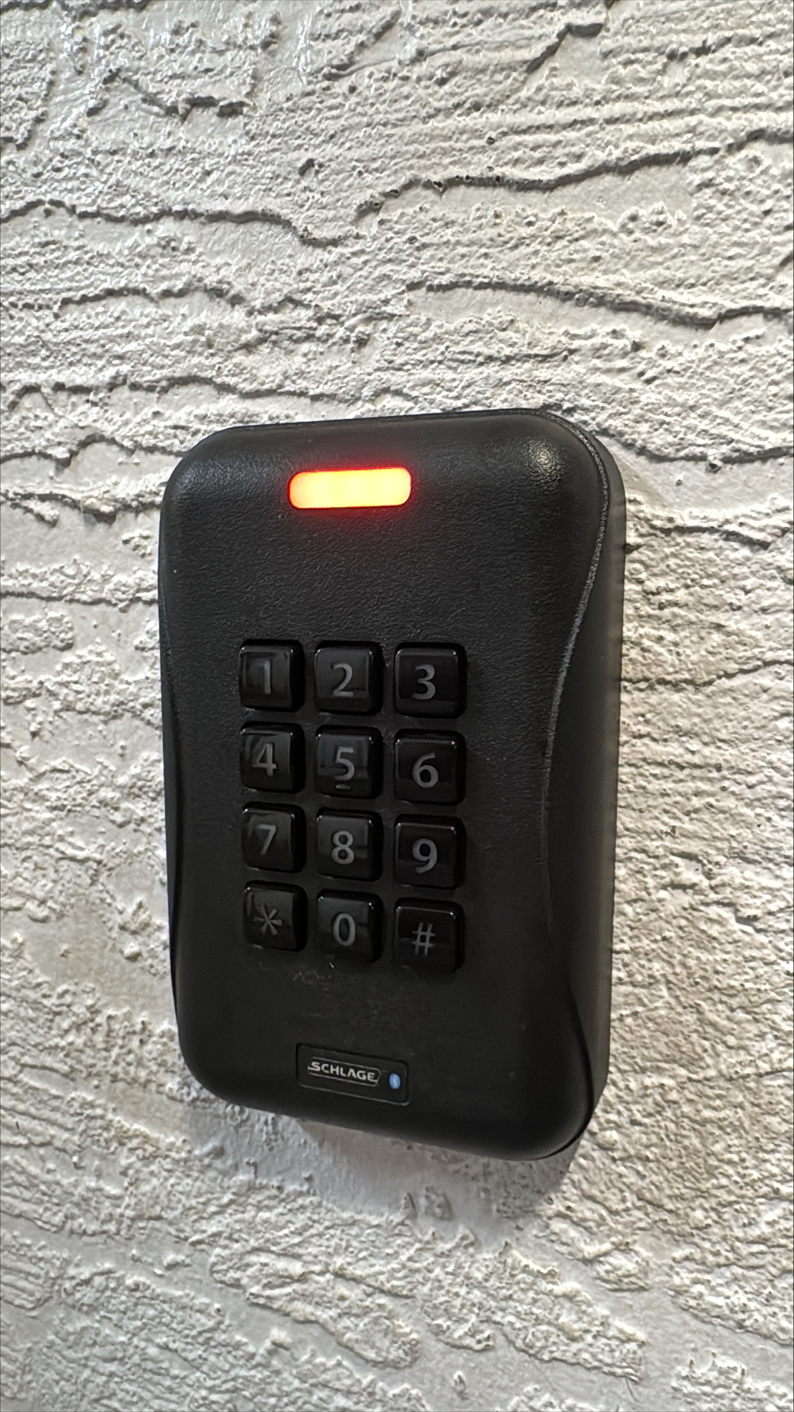

Quick Tips From the IT Department
New student's lunch numbers will be entered and working by the end of this week. Students can use their lunch number on keypads to enter student areas.
All student passwords have been reset! New passwords are in the following format: MMDDYYYYfl
Where MMDDYYYY is your birthday, and fl is your first initial + last initial. Ex: 06112009jd
New student logins can be found by going to https://colegia.org/student/lookup, selecting St. Lucie County, and entering the student's 562#.
Any questions? Please email support@somersetcollegeprep.org for IT support.

Slide 22

Tell an adult in our school!

Slide 23

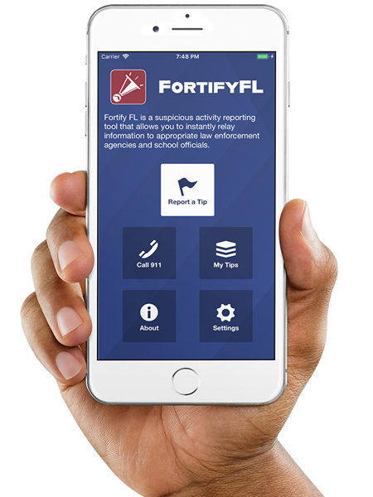
Anonymous Reporting App

Slide 24
ATTENTION STUDENTS!!
Did you know that the Florida Department of Law Enforcement and the Florida Department of Education created an anonymous reporting App that allows you to instantly send information about suspicious activity to local law enforcement and school officials?

Slide 25
WHY?
It is important to always remember that If You See Something, Say Something! With FortifyFL, you can easily submit information about potential crimes or threats which will immediately be forwarded to law enforcement and designated school personnel.

Slide 26
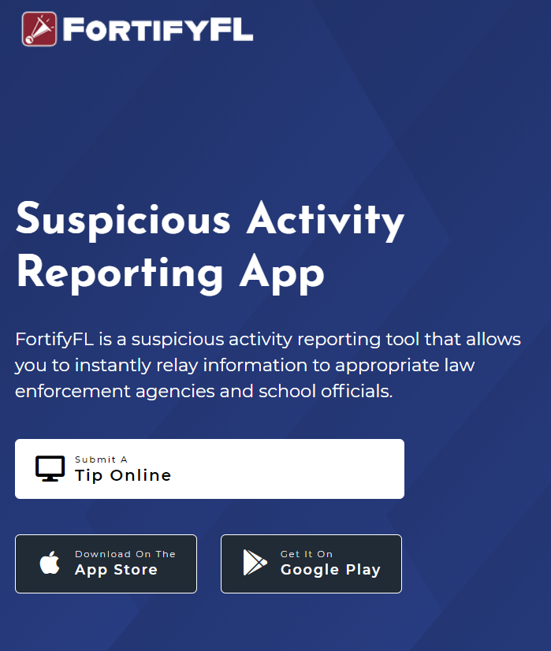
HOW DO I SUBMIT A TIP?
You can submit a tip from any computer at: https://getfortifyfl.com/

Slide 27
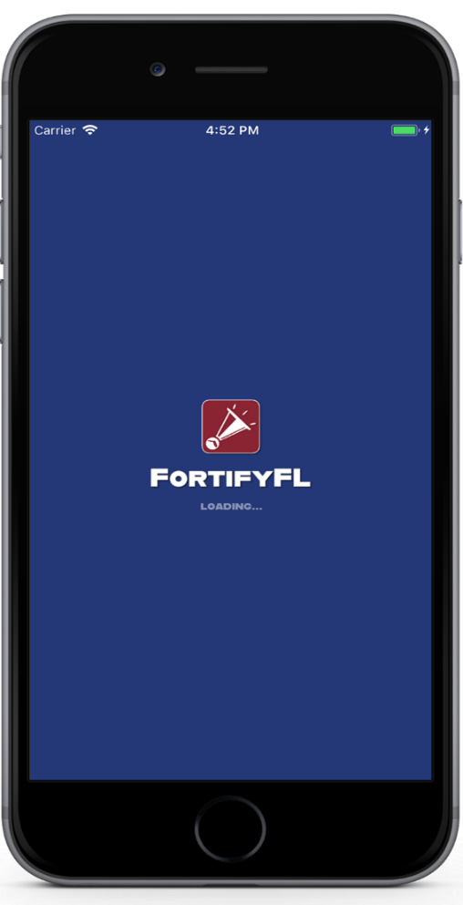

HOW DO I SUBMIT A TIP?
You can also submit a tip using your cell phone. Download the FortifyFL App on your mobile device.

Slide 28
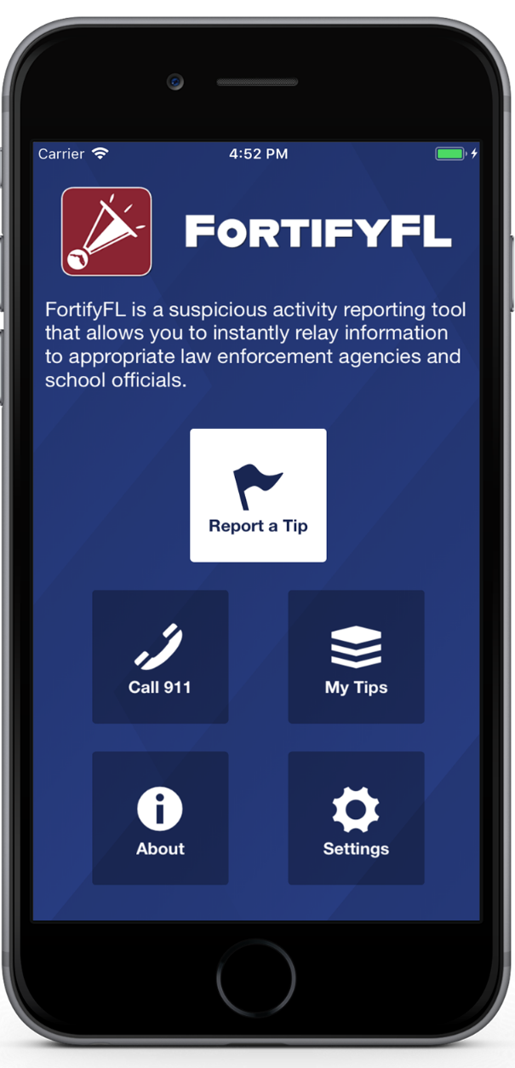
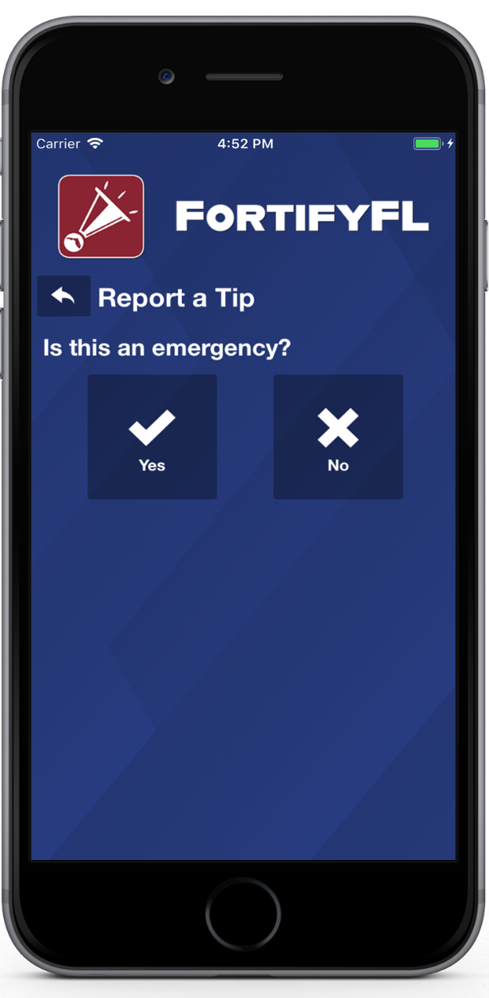
HOW DO I SUBMIT A TIP?
Click “Report a Tip,” and indicate if it is an emergency

Slide 29
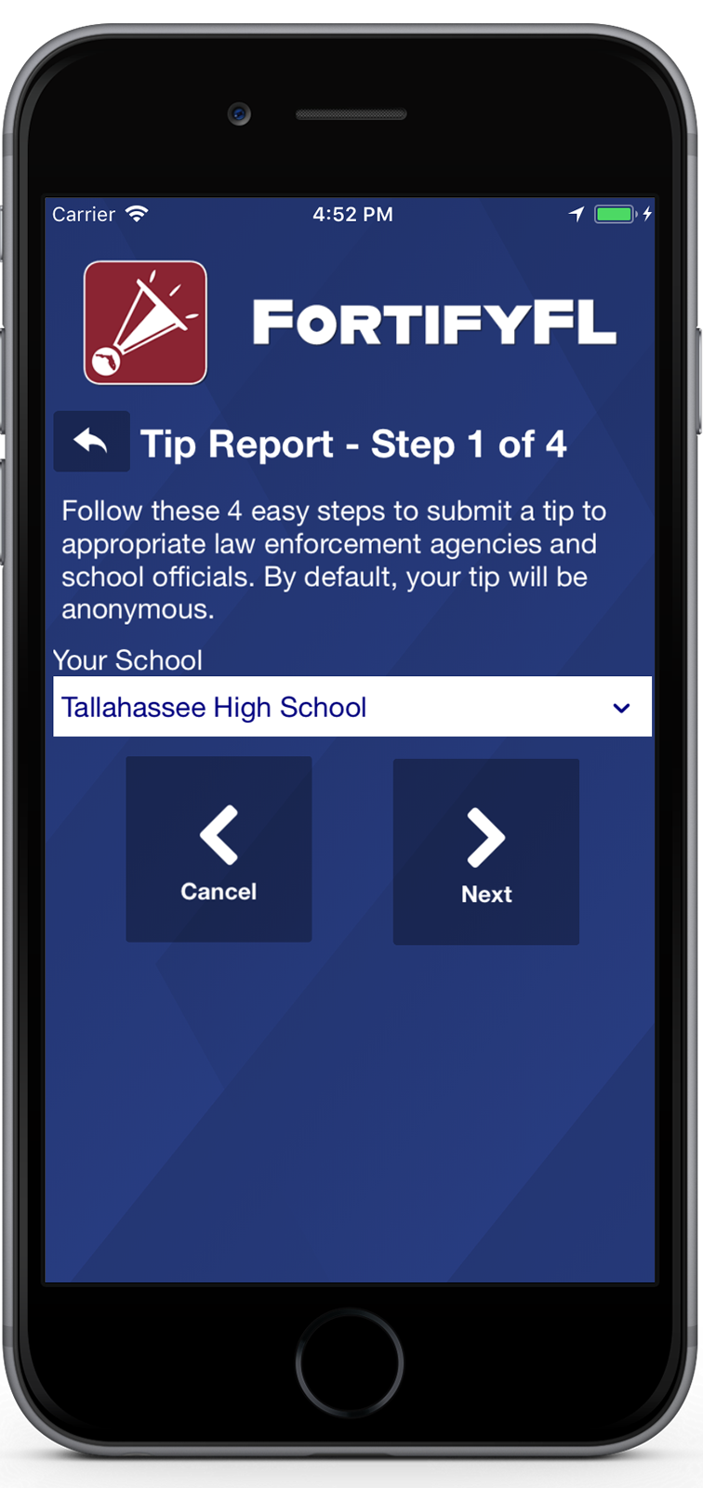
HOW DO I SUBMIT A TIP?
Step 1: Select Your School

Slide 30
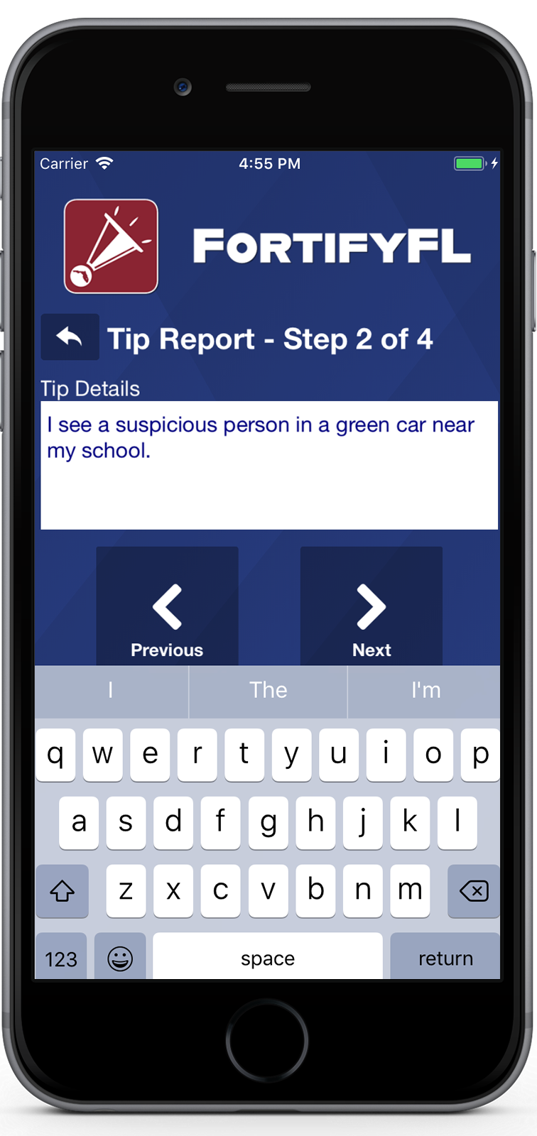
HOW DO I SUBMIT A TIP?
Step 2: Provide Your Tip

Slide 31
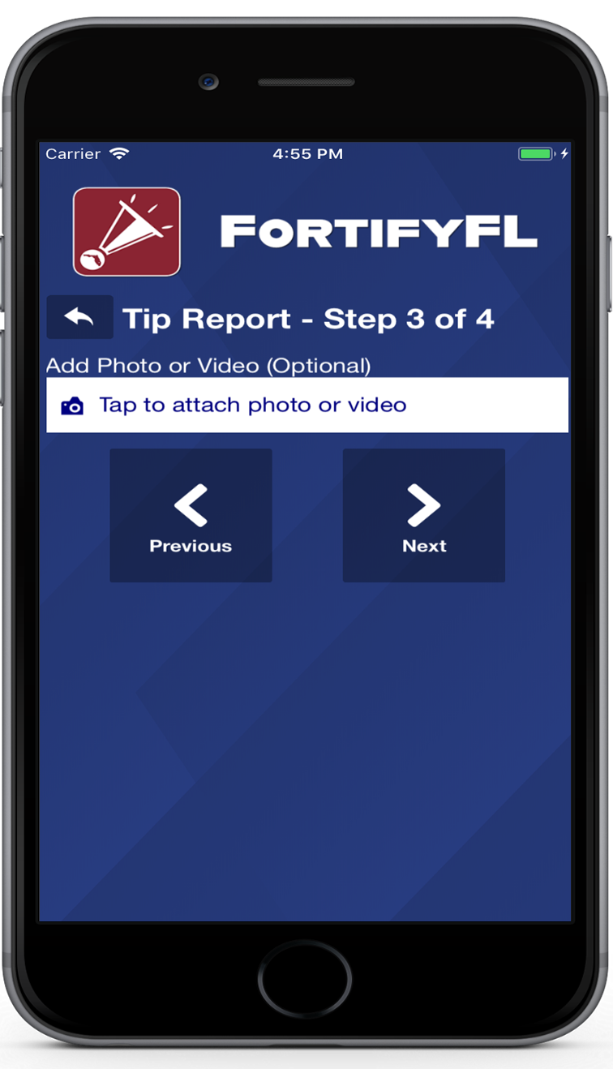
HOW DO I SUBMIT A TIP?
Step 3: Attach an Optional Photo or Video

Slide 32
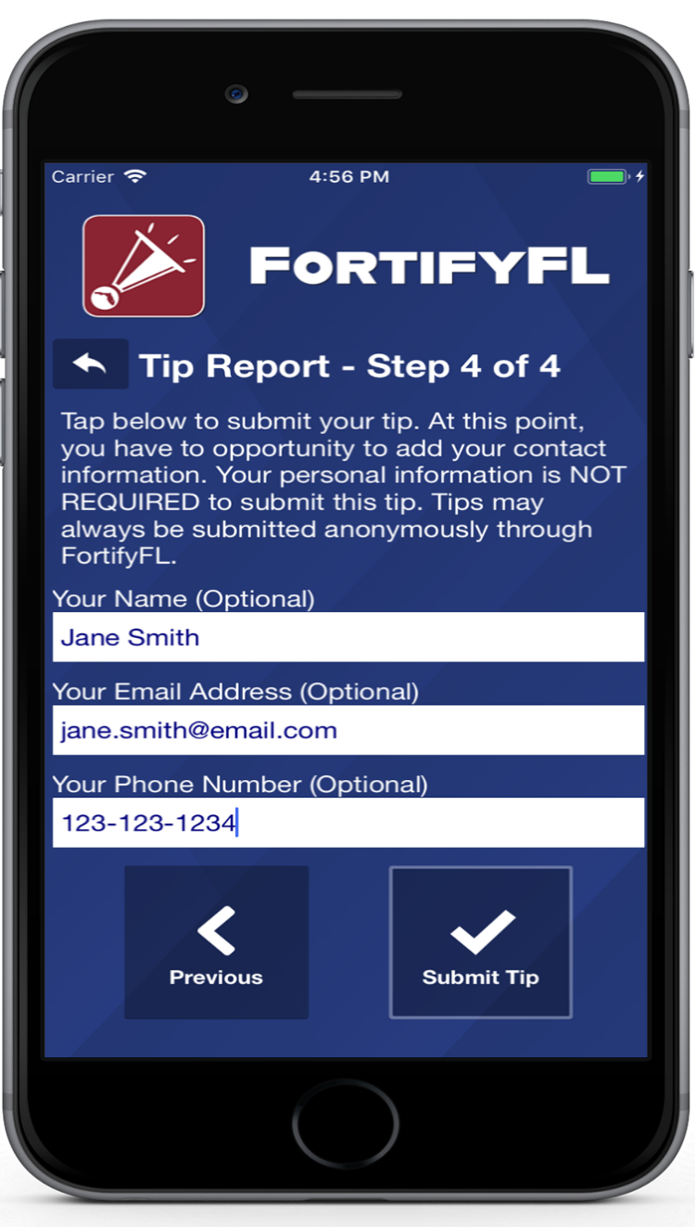
HOW DO I SUBMIT A TIP?
Step 4: Provide Optional Information and Submit Your Tip

Slide 33
False Tips Lead to possible Criminal penalties
If someone who knowingly submits a false tip through FortifyFL may be subject to further investigation by law enforcement, and may be subject to criminal penalties under Section 837.05, F.S.

Slide 34
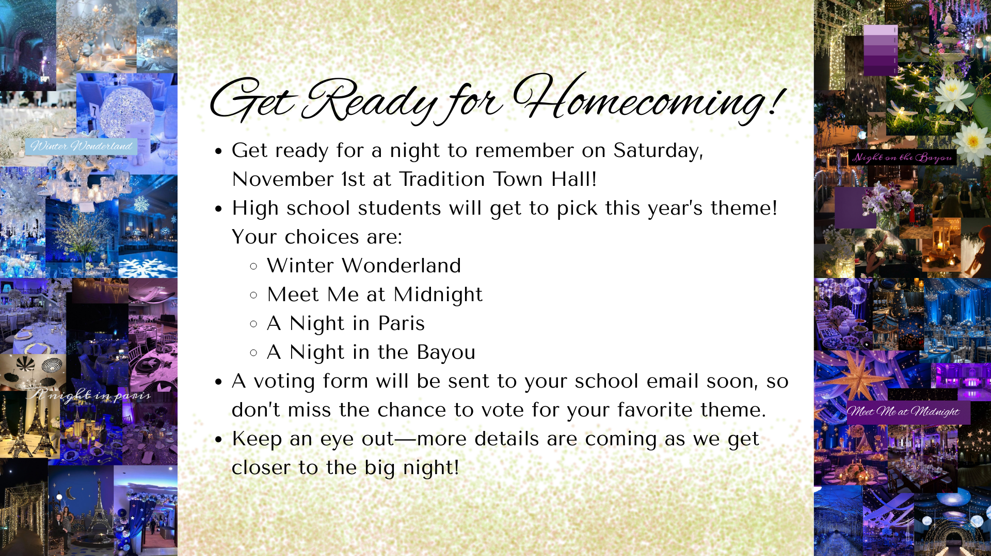

Slide 35




Homecoming
Ideas
2025

Slide 36

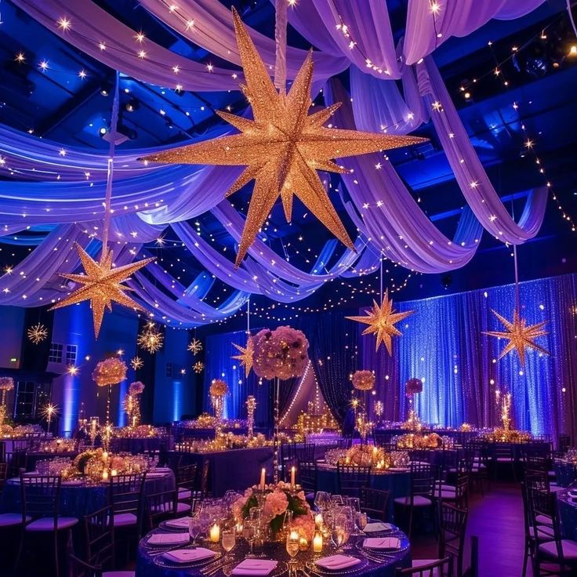
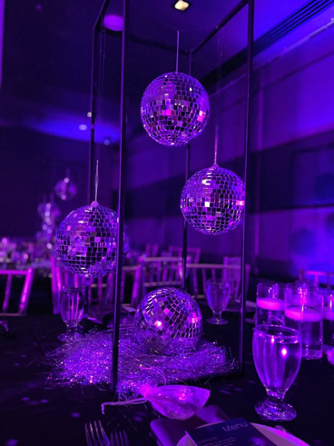
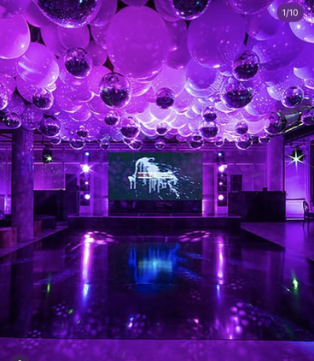
Starry Night

Slide 37

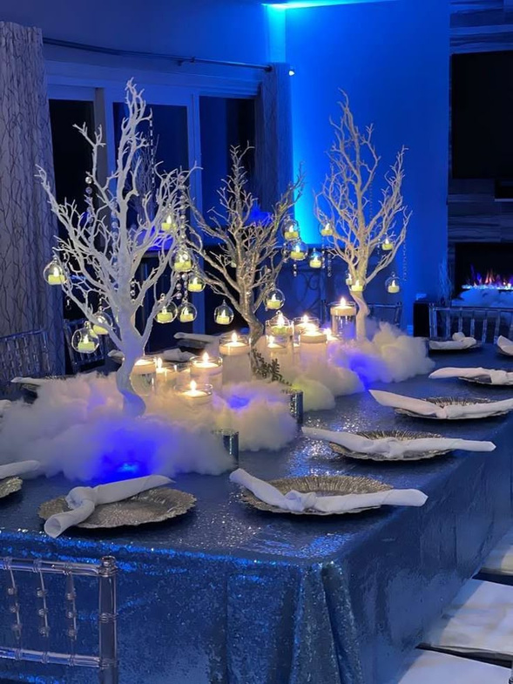

Winter Wonderland

Slide 38
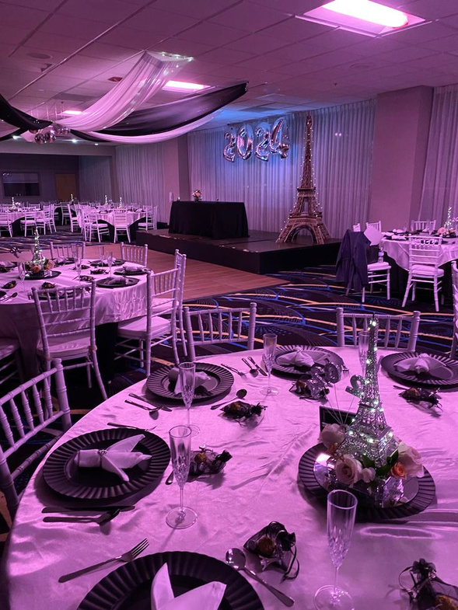

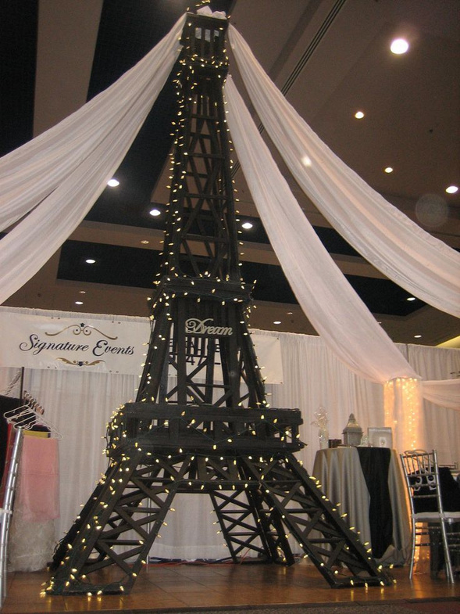
Night in Paris

Slide 39
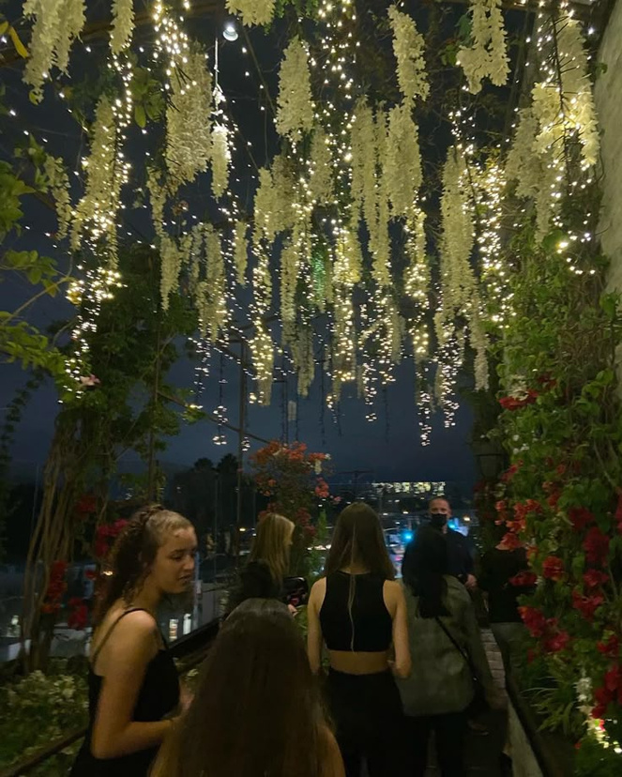

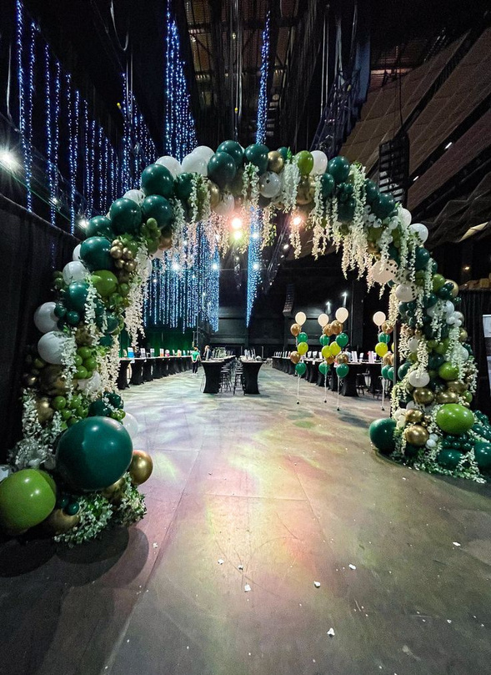
Night on the Bayou

Slide 40


Slide 41

rocket league tournament club
where rocket powered cars make legendary goals
The sign up and get information go to
https://bit.ly/Somersetrlclub
For more info contact dcohe003@somerset.colegia.org

Slide 42


Slide 43


Slide 44

Interested in starting a school club?
If you’re interested in starting a school club, you should do the following:
  Find a teacher to sponsor the club. Give them the details about the club so they know if they’re able to sponsor the club.
  Create a petition and get students who would be interested in your club to sign it. This shows that your club has generated interest.
  Talk to someone in administration about getting your club approved. Tell them who the sponsor is, when the club will occur (lunch or afterschool), and what the club entails.
  Email Mr. Kyryliw (Kyryliw.Michael@somersetcollegeprep.org) the information about you club and a slide advertising it. I will leave the advertising slide up for a week or so and create a slide listing all the club information for easy reference.

Slide 45


Slide 46

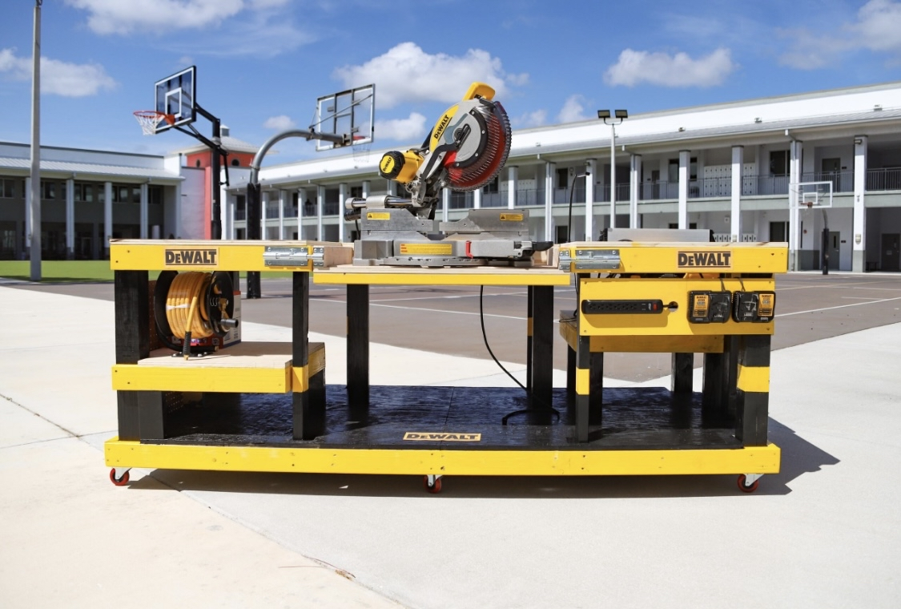
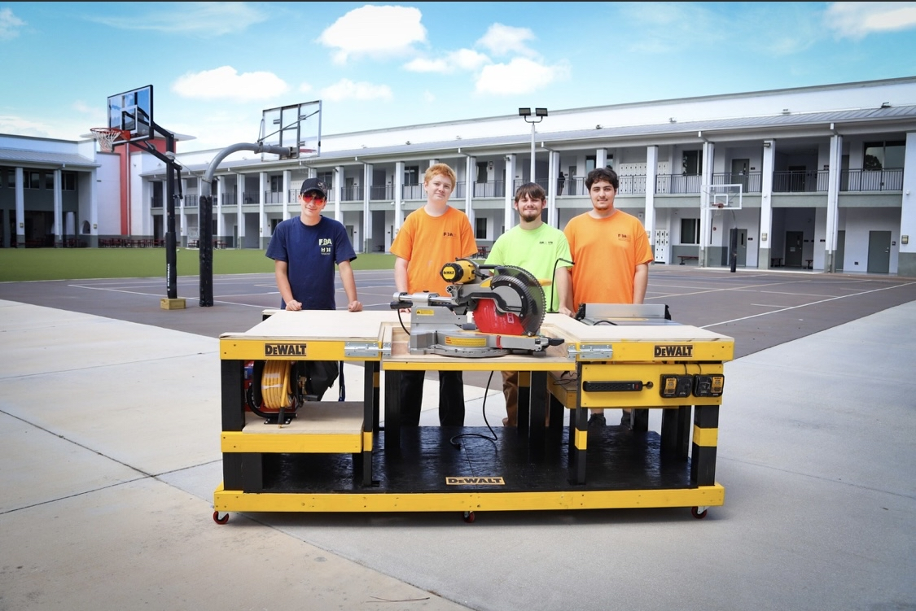
MEETING AT LUNCH
IN ROOM 175
COME JOIN US!
-Interested in joining Somerset Career Academy’s FBA Chapter?
-Last year the students won 1st place with a workbench island designed and built for the SEBC competition.
-Interest Meeting Thursday 8/21/2025 at lunch in room 175
-Three day field trip learning multiple skilled trades every spring.

Slide 47


Slide 48


Slide 49







Are you interested in NSHS?
Well look no further! Here’s all you need to know to join:
Requirements:
-3.5 overall GPA
-3.5 unweighted GPA in all science courses
-2 subsequent science courses within the same subject like Biology
Example: Chemistry 1 Honors (High school level) AND Chemistry
1 at IRSC (or an AP level Chemistry)
What you need to know before you join:
-We meet every other Friday (subject to change)
-Ms. Sandum is the sponsor
-Any grade can join, as long as you meet the requirements and are accepted
Applications:
-They will start September 1st
-They will be on paper
-Where: Ms. Sandum or the front office
-You can turn the application in to Ms. Sandum’s classroom or email a scanned version to sandum.kathryn@somersetcollegeprep.org.
-Deadline October 10th (end of quarter)
Any further questions you contact either ewitt002@somerset.colegia.org or sandum.kathryn@somersetcollegeprep.org

Slide 50
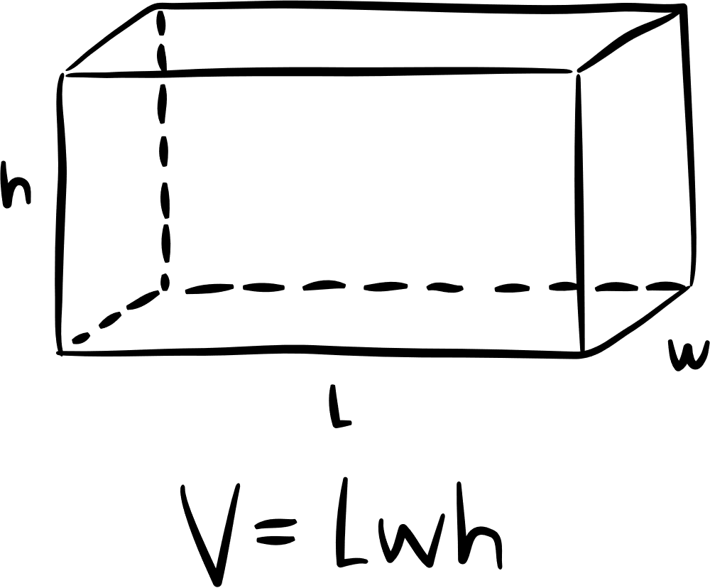

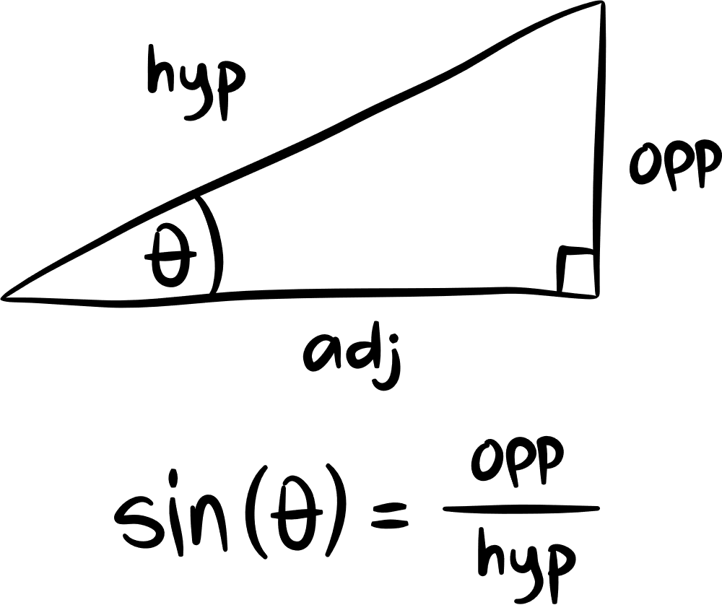


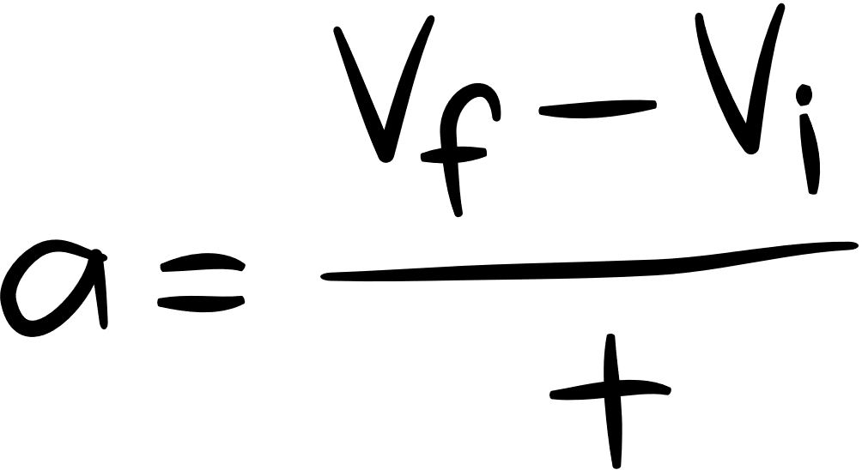

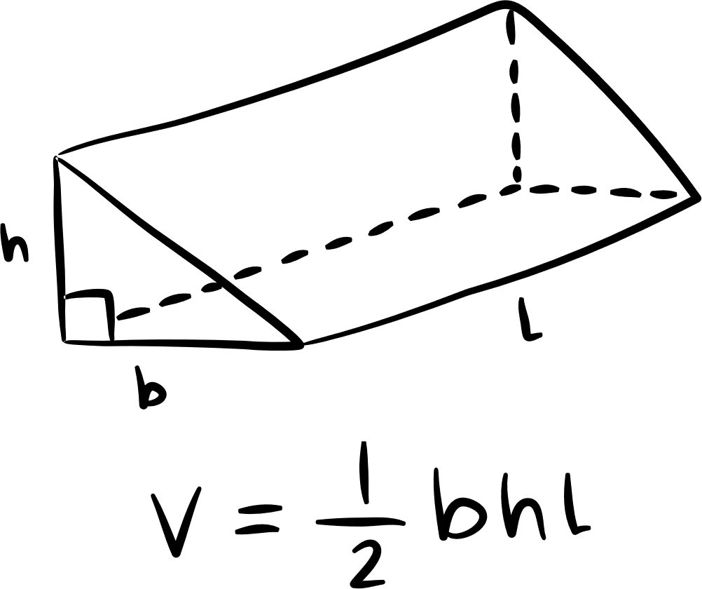
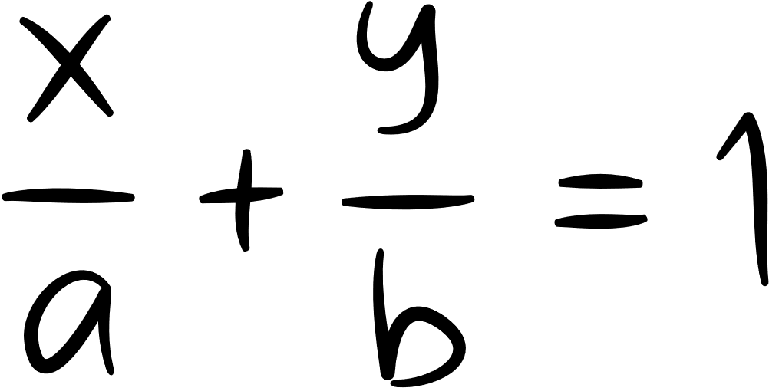

Interested in Joining
Math Honors Society​?
SCPA requirements:​
9th -12th grade​
3.5 Math GPA​
3.0 Overall GPA​
Have taken Algebra 1 and geometry​
Currently taken or enrolled in higher level math ​
SCA requirements:​
9th -12th grade​
3.0 Math GPA​
3.0 Overall GPA​
Have taken Algebra 1 and geometry​
Currently taken or enrolled in higher level math ​
Any questions?​
Email our sponsor Mrs. Ageeb (ageeb.linda@somersetcollegeprep.org)​ or our 2025-2026 President Maximus Dill (mdill004@somerset.colegia.org)

Slide 51
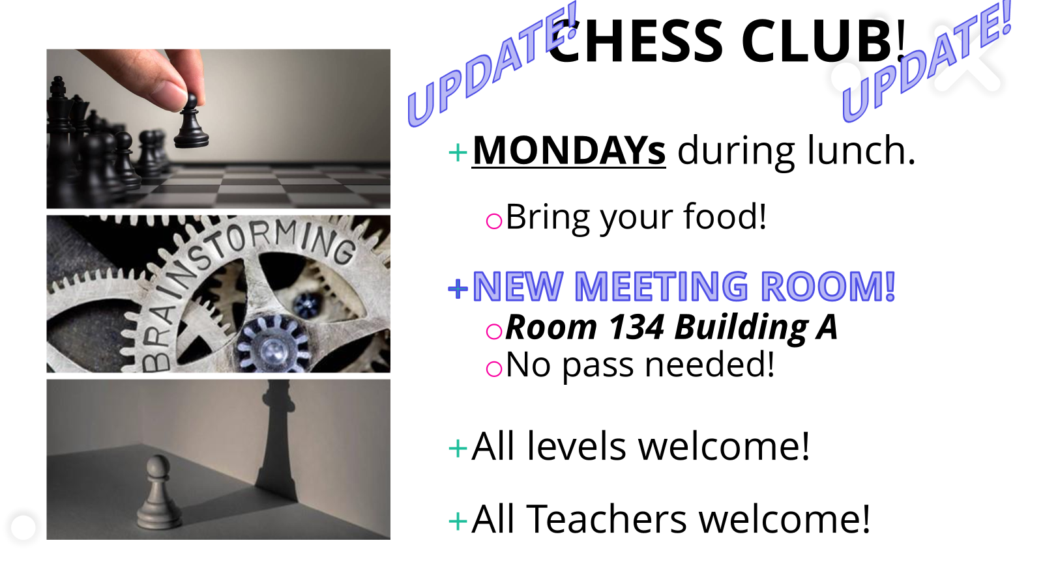

Slide 52
School Club List
Monday
Chorus (High School)- afterschool from 4-5:30
Chess- at lunch, in 134A
Boxing Club- Mondays and Wednesdays in the weight room afterschool, from 4-5:15
Neurons and Newtons- at lunch, in 243B
Dungeons and Dragons- afterschool, in 175c, from 3:50-5:15
Tuesday
K-Pop- at lunch, in 230A
Drama- afterschool in 167c, 4-5pm
Wednesday
SGA- Afterschool at 4pm
First Priority- at lunch in the gym
Thursday
Artists for a Cause- at lunch, in 268c
Future Builders of America- at lunch in 175c
Prom Committee/Planning- 276A at lunch
Friday
Gay-Straight Alliance- at lunch, in 169c

Slide 53

Dungeons & Dragons Club
READY FOR ADVENTURE, THRILLS, AND FANTASY?
D&D CLUB MEETINGS
MONDAYS AT 3:50 TO 5:15 PM
ROOM 175

Slide 54

-Library is open during lunch Monday - Thursday’s
-Closed on Fridays.
Mondays and Tuesdays- Open to Middle School
Wednesdays and Thursdays- Open to High School

Slide 55


